Slide 1
Weekly Report
Wensheng Cheng
2022.2.15-2.21

Slide 2
Last discussion
Explore why the baseline model can’t capture some objects visually similar to the template.
The object is missed at which stage, backbone, QG-RPN, or QG-RCNN?
Conclusion: RPN. A typical example is the airplane img.
Backbone influence on the problem, Swin or ResNet?
Conclusion: Not uniform. Swin gets better results on some sequences than ResNet, but ResNet also gets better results on other sequences.
Thoughts: SOT pretrained RPN is bad for our task, since it decreases the response of some objects similar with the template, try the one pretrained on detection task.

Slide 3
This week
No use QG-RPN(baseline), try to combine RPN(coco) with correlation based heatmap. RPN extracts objects, and heatmap chooses those similar with the template.
Can RPN(coco) extract all target objects?
Conclusion: basically yes, it can find target objects which QG-RPN(baseline) cannot find, but many FP are introduced.
How to combine RPN with heatmap?
Ans: multiply the heatmap with the cls_score of RPN output, and scale limitation can also be used.
Conclusion: it could remove some FP, but current heatmap itself is not good enough, so the process still needs improvement.

Slide 4
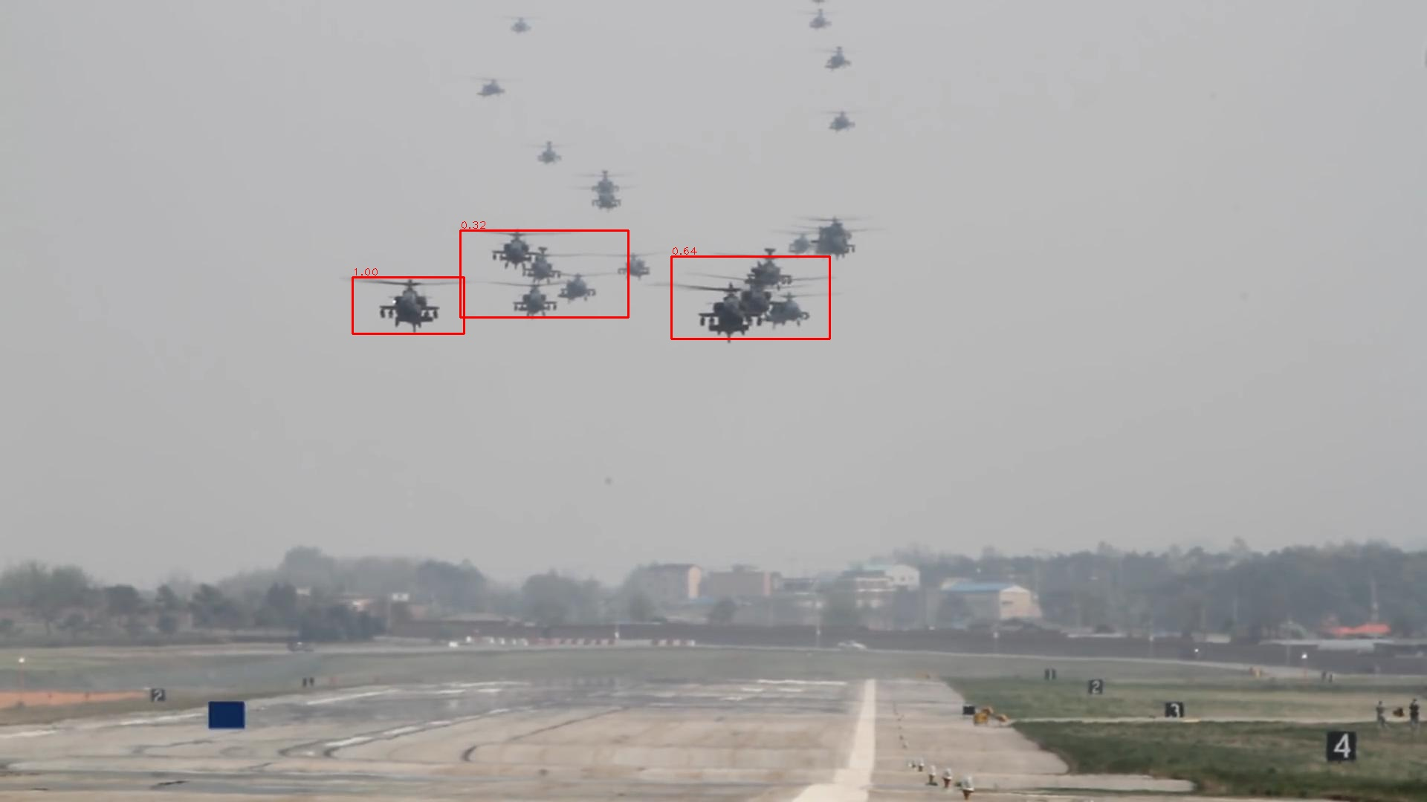
QR-RPN-Baseline Proposals
The model(Res50 backbone, QR-RPN head) is pretrained on large SOT datasets(vis_score_th_01).

Slide 5
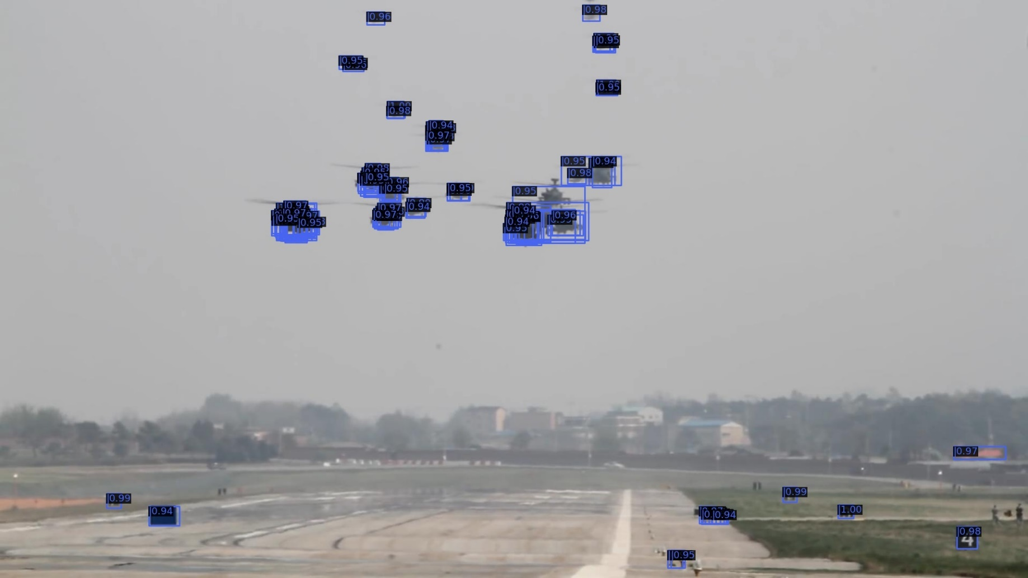
RPN-COCO Proposals
The model(Res50 backbone, RPN head) is pretrained on COCO dataset(RPN_out_top_100_vis_score_th_01).

Slide 6

QR-RPN-Baseline Proposals

Slide 7

RPN-COCO Proposals

Slide 8

QR-RPN-Baseline Proposals

Slide 9
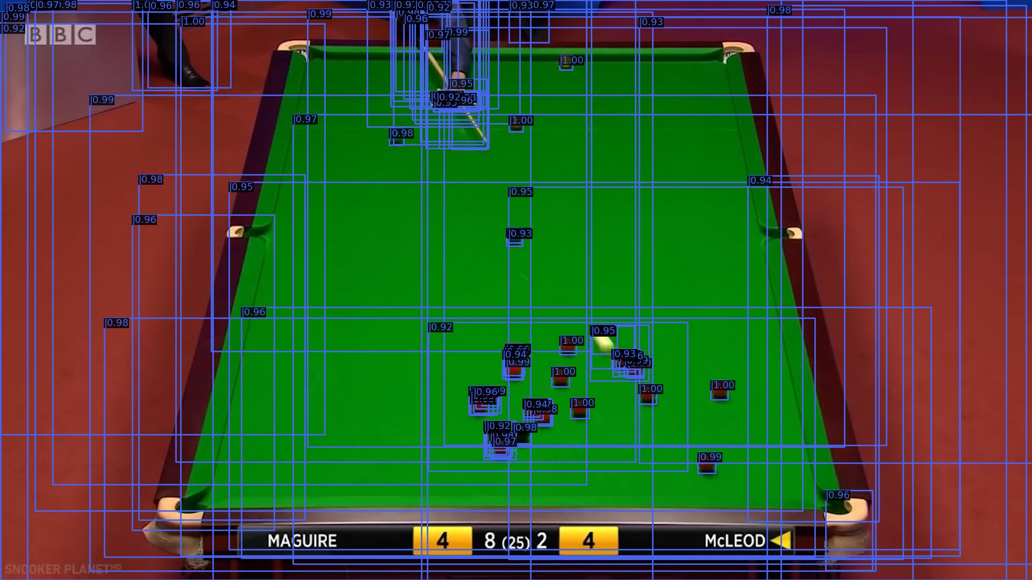
RPN-COCO Proposals

Slide 10
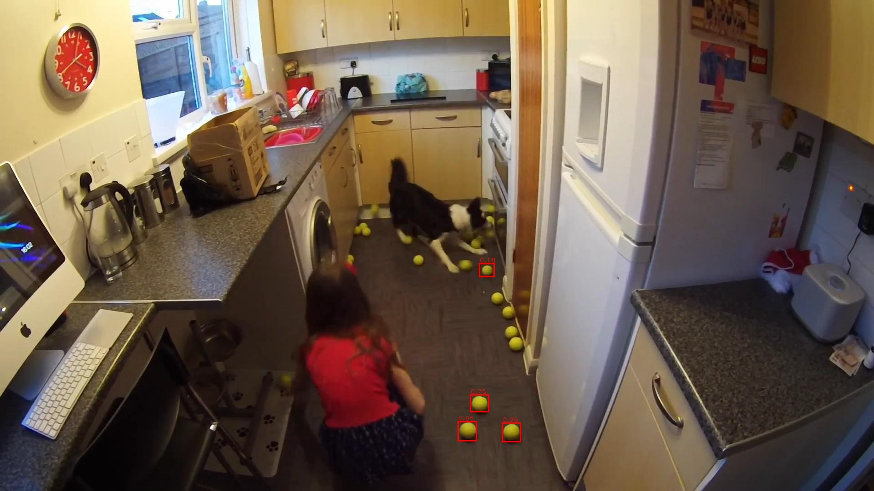
QR-RPN-Baseline Proposals

Slide 11
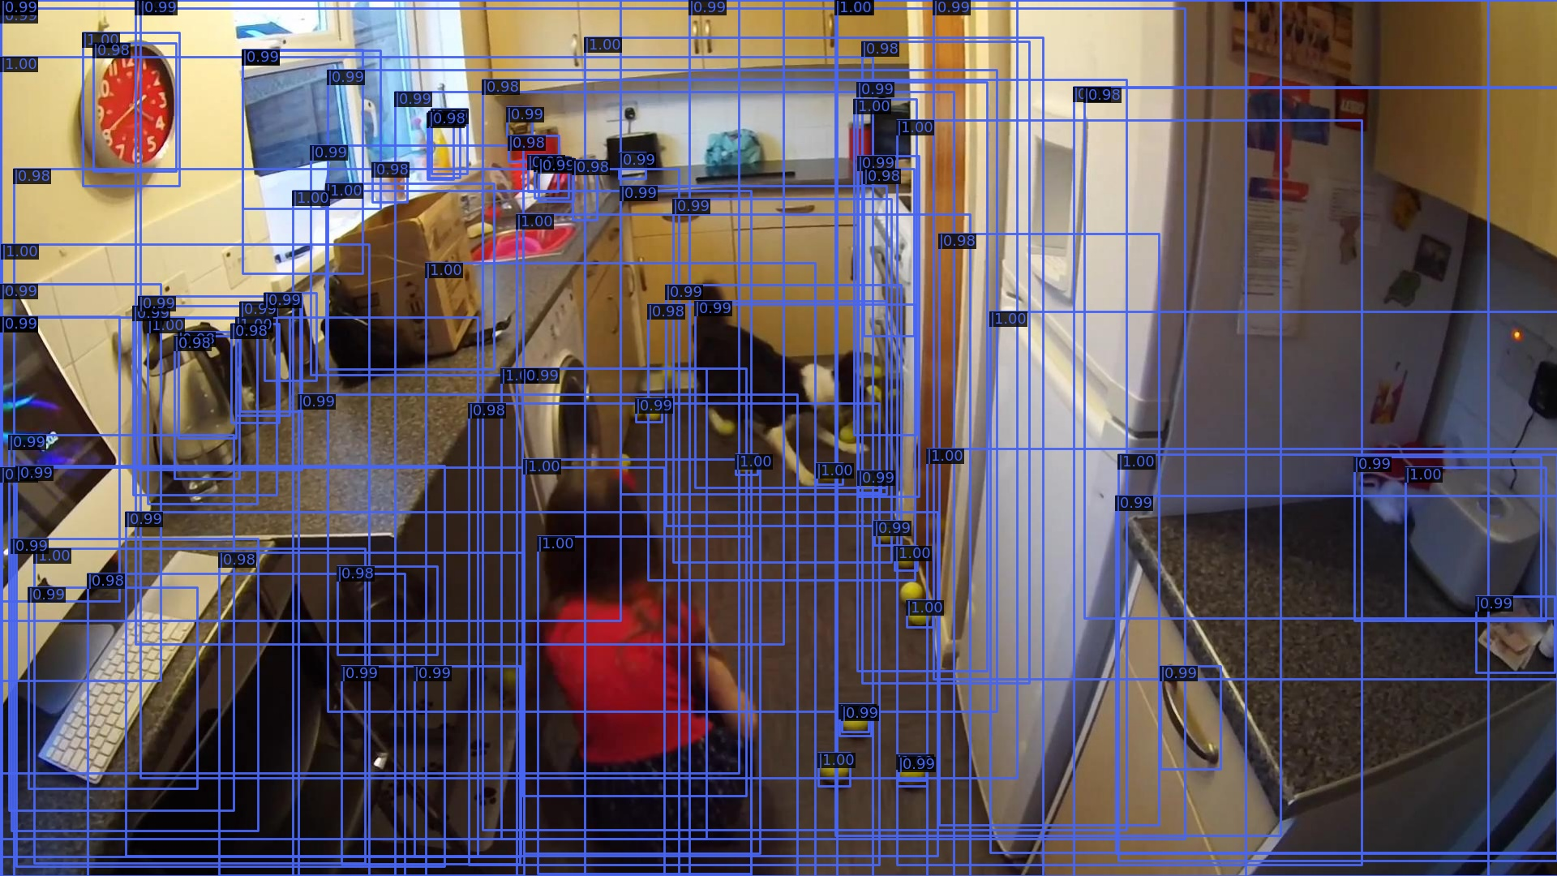
RPN-COCO Proposals

Slide 12
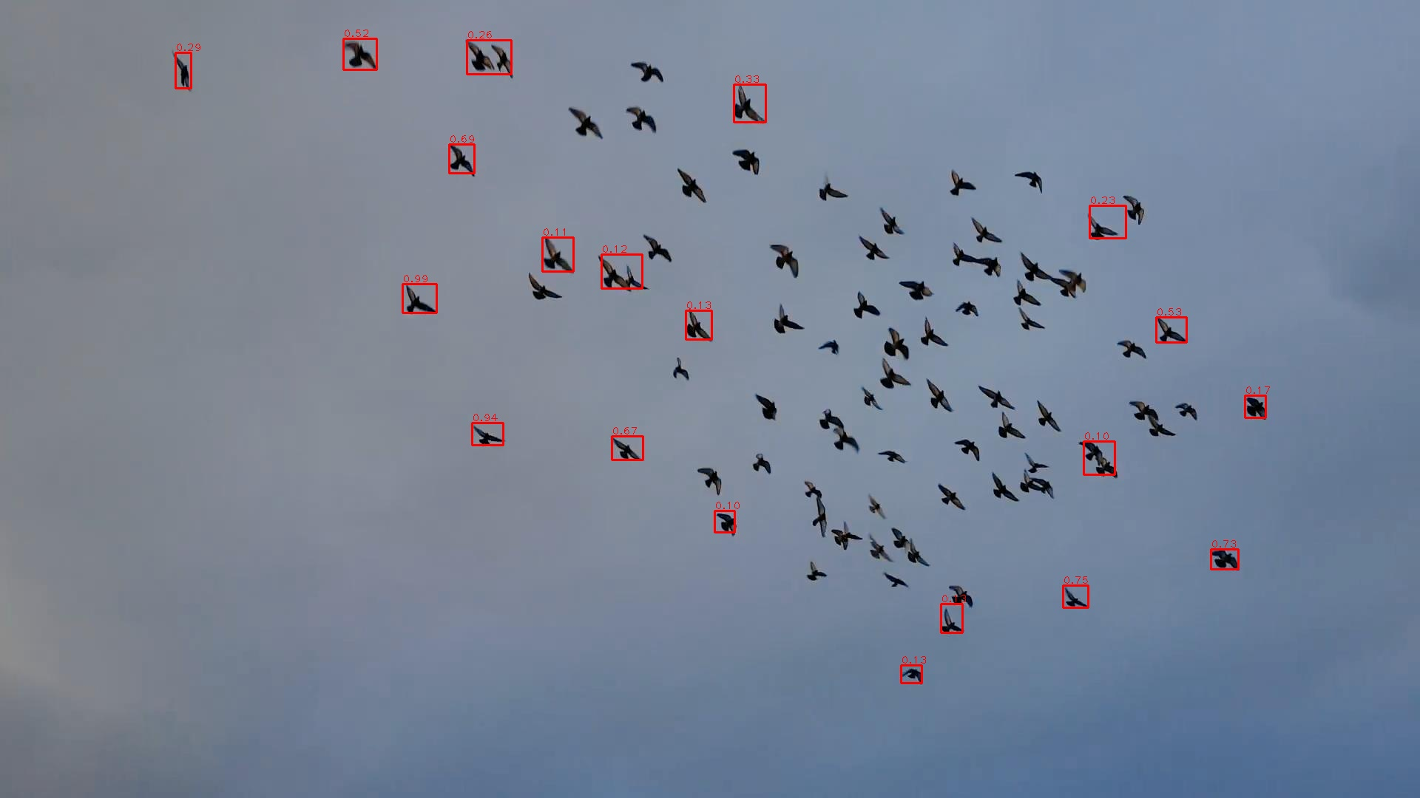
QR-RPN-Baseline Proposals

Slide 13

RPN-COCO Proposals

Slide 14
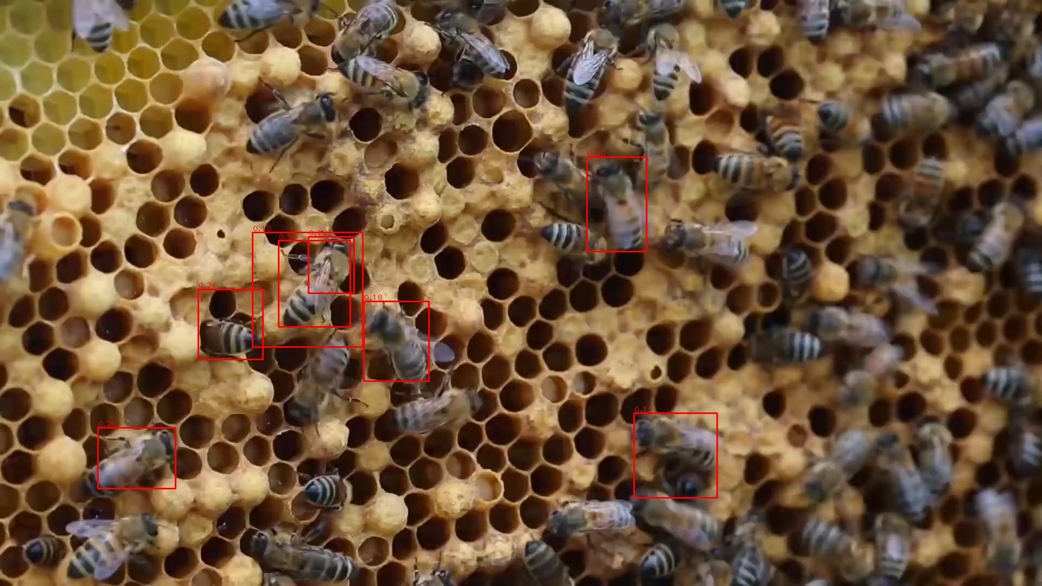
QR-RPN-Baseline Proposals

Slide 15
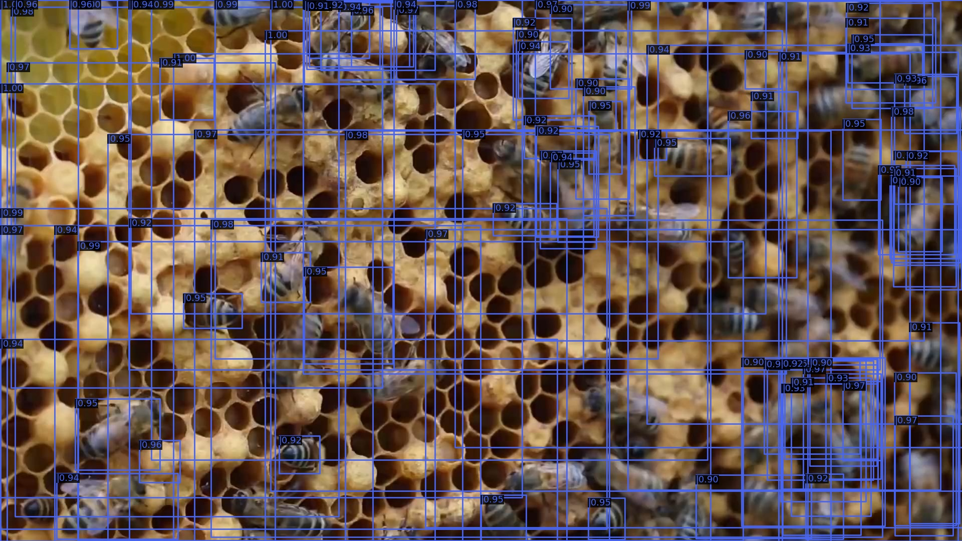
RPN-COCO Proposals

Slide 16
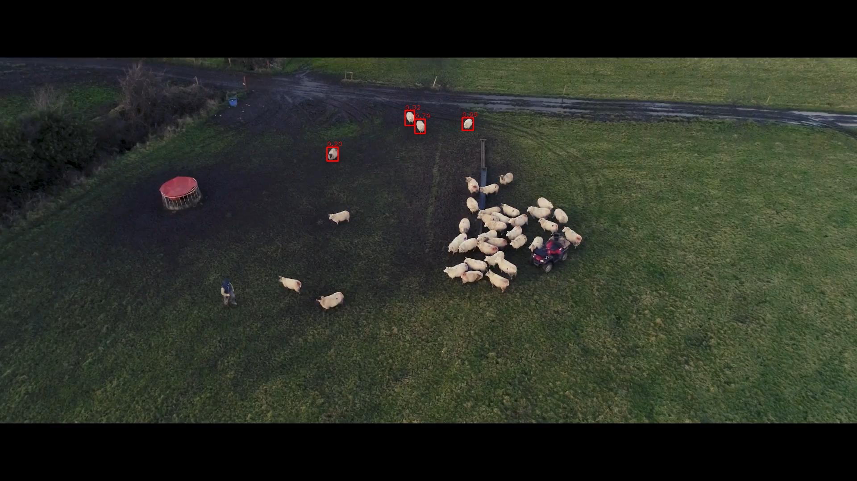
QR-RPN-Baseline Proposals

Slide 17
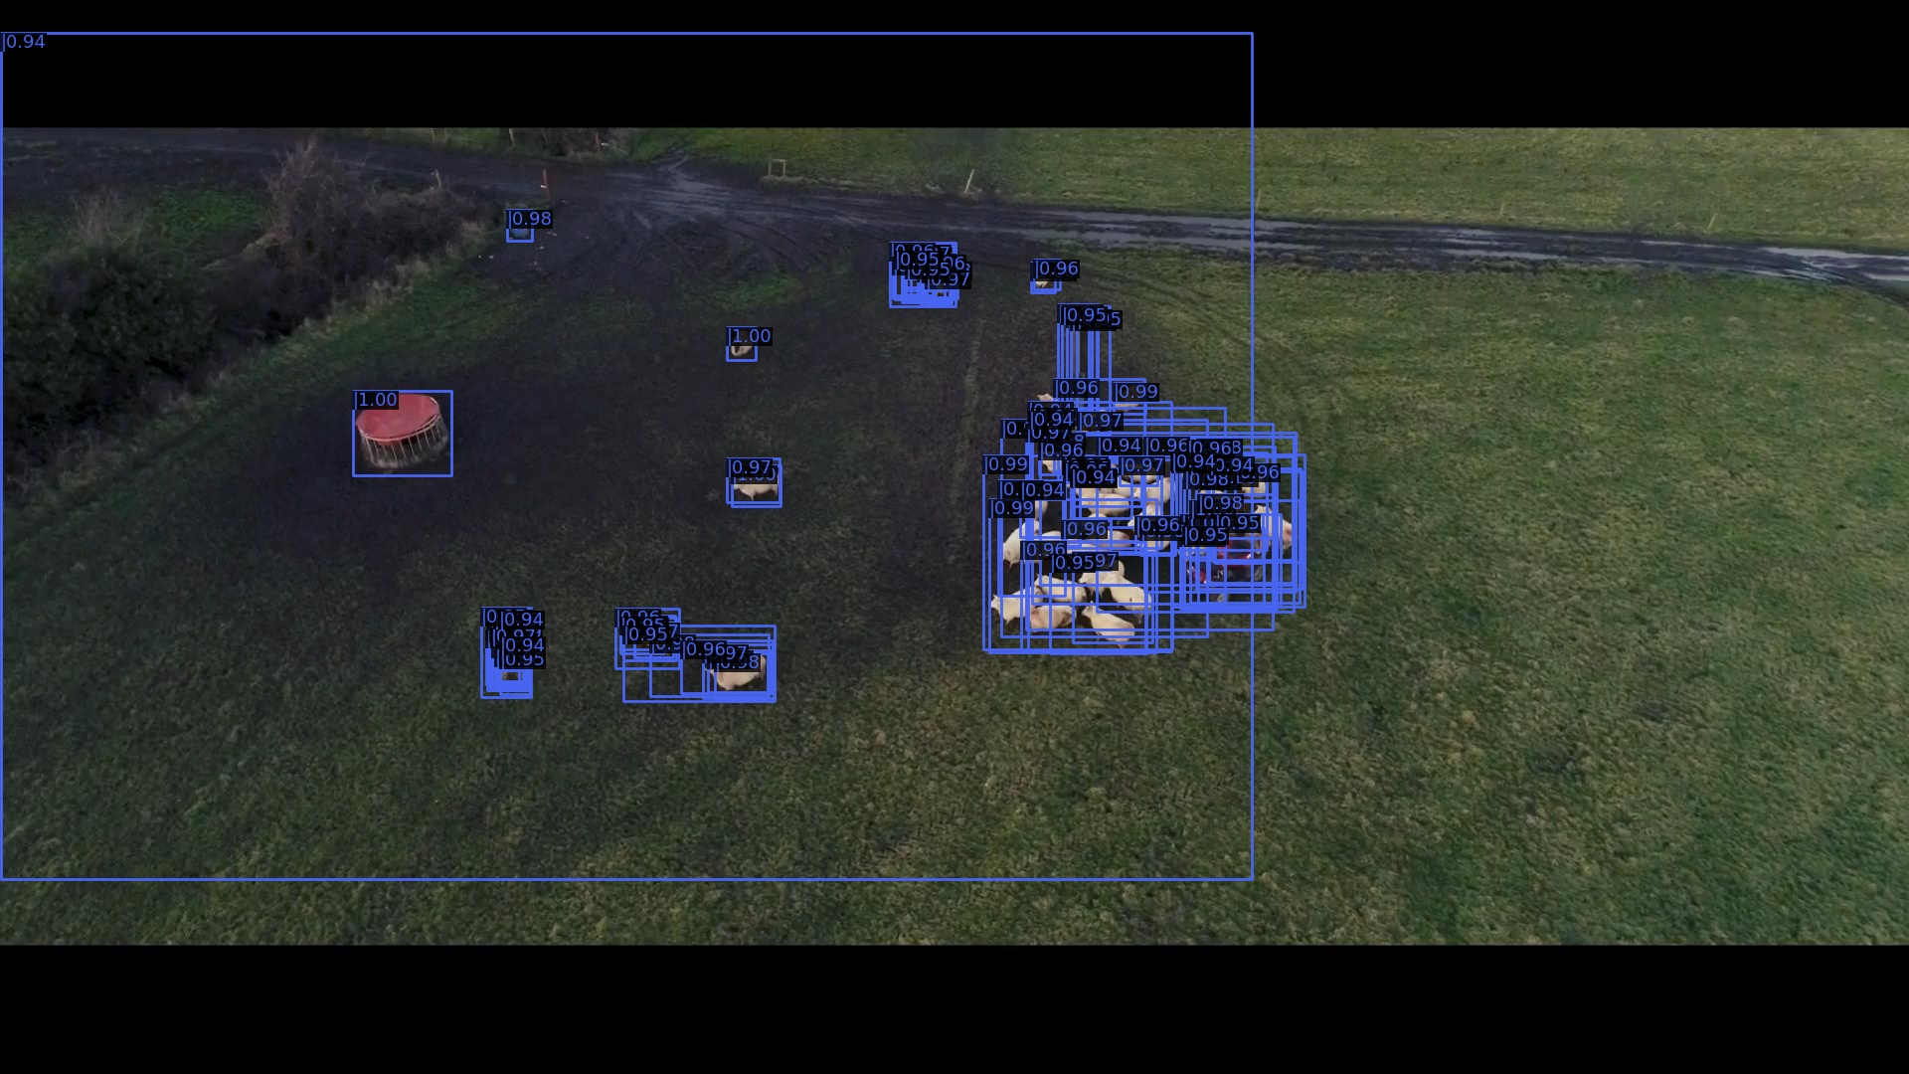
RPN-COCO Proposals

Slide 18
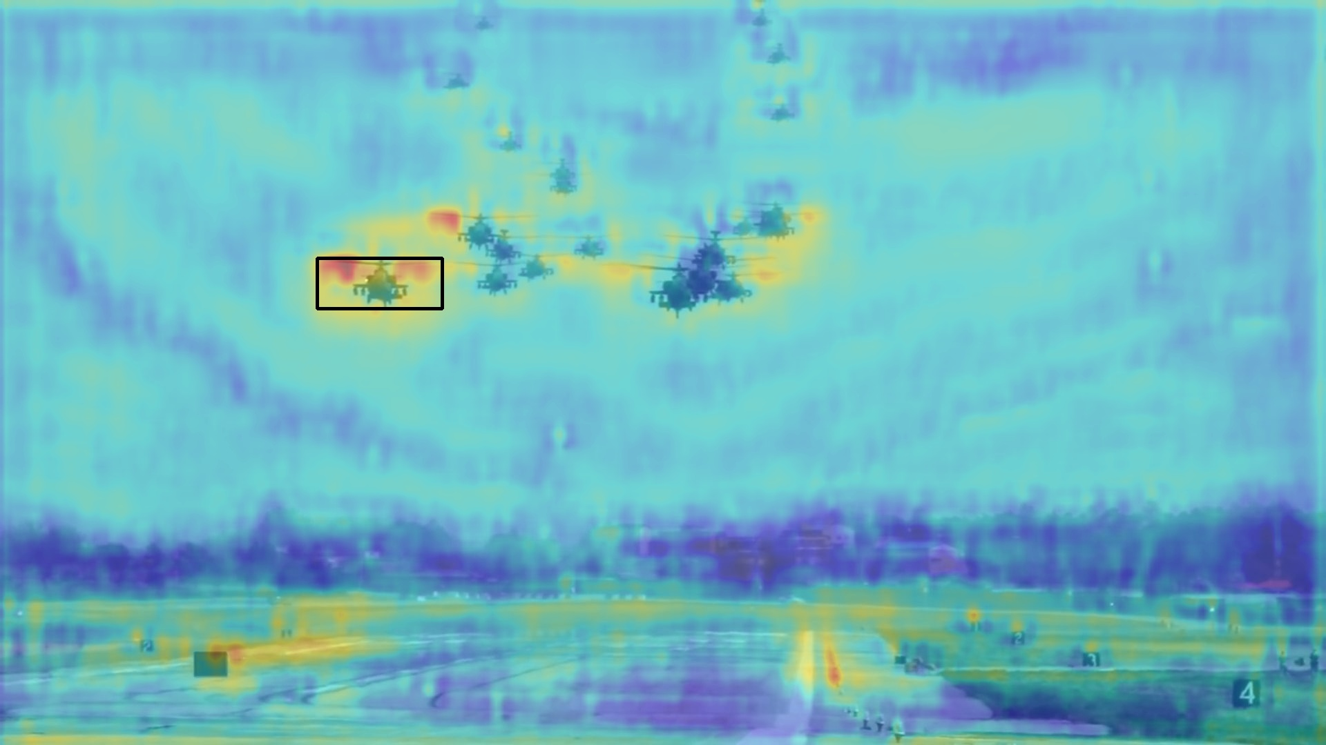
Combine Correlation Heatmap with RPN
Multiply heatmap with cls_score of RPN on all FPN scales.

Slide 19
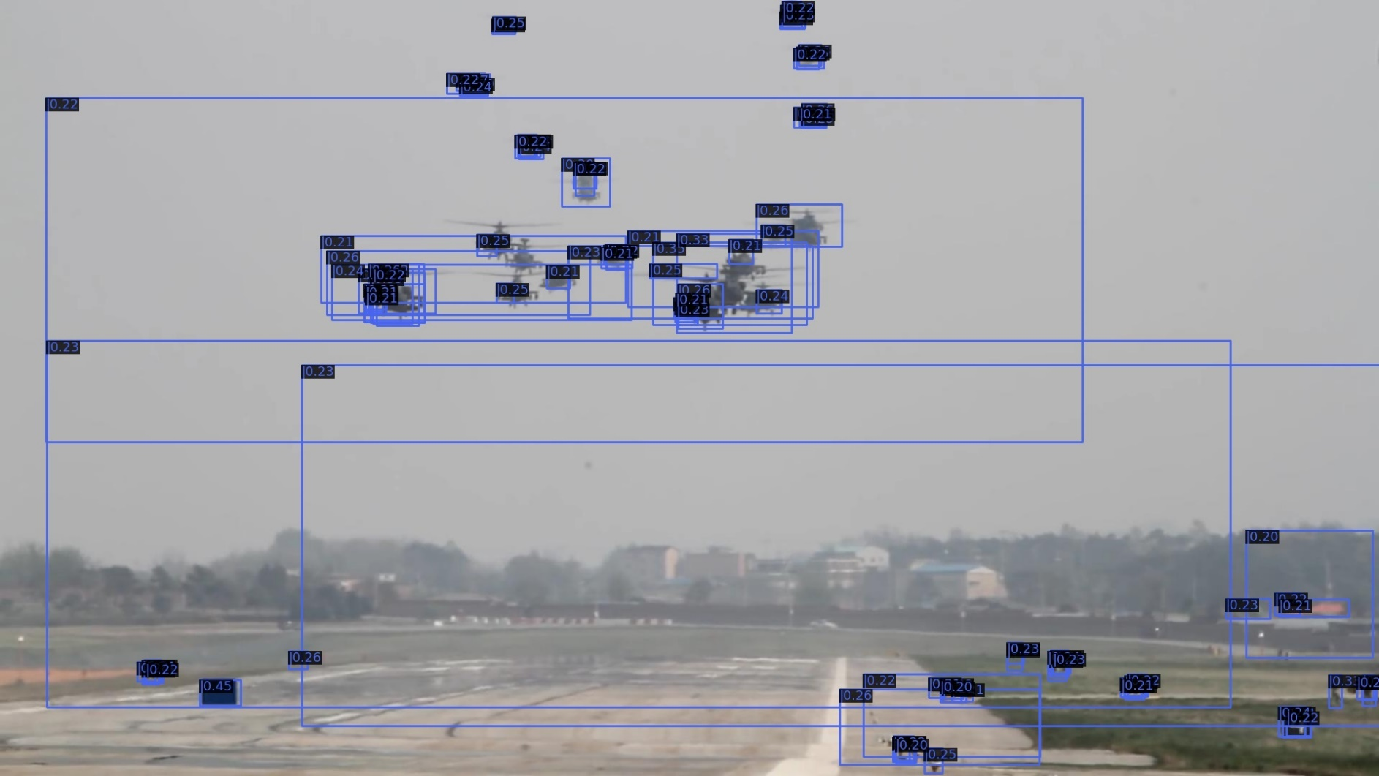
Combine Correlation Heatmap with RPN
Multiply heatmap with cls_score of RPN on all FPN scales.

Slide 20

Combine Correlation Heatmap with RPN
Multiply heatmap with cls_score of RPN on all FPN scales.

Slide 21

Combine Correlation Heatmap with RPN
Multiply heatmap with cls_score of RPN on all FPN scales.

Slide 22
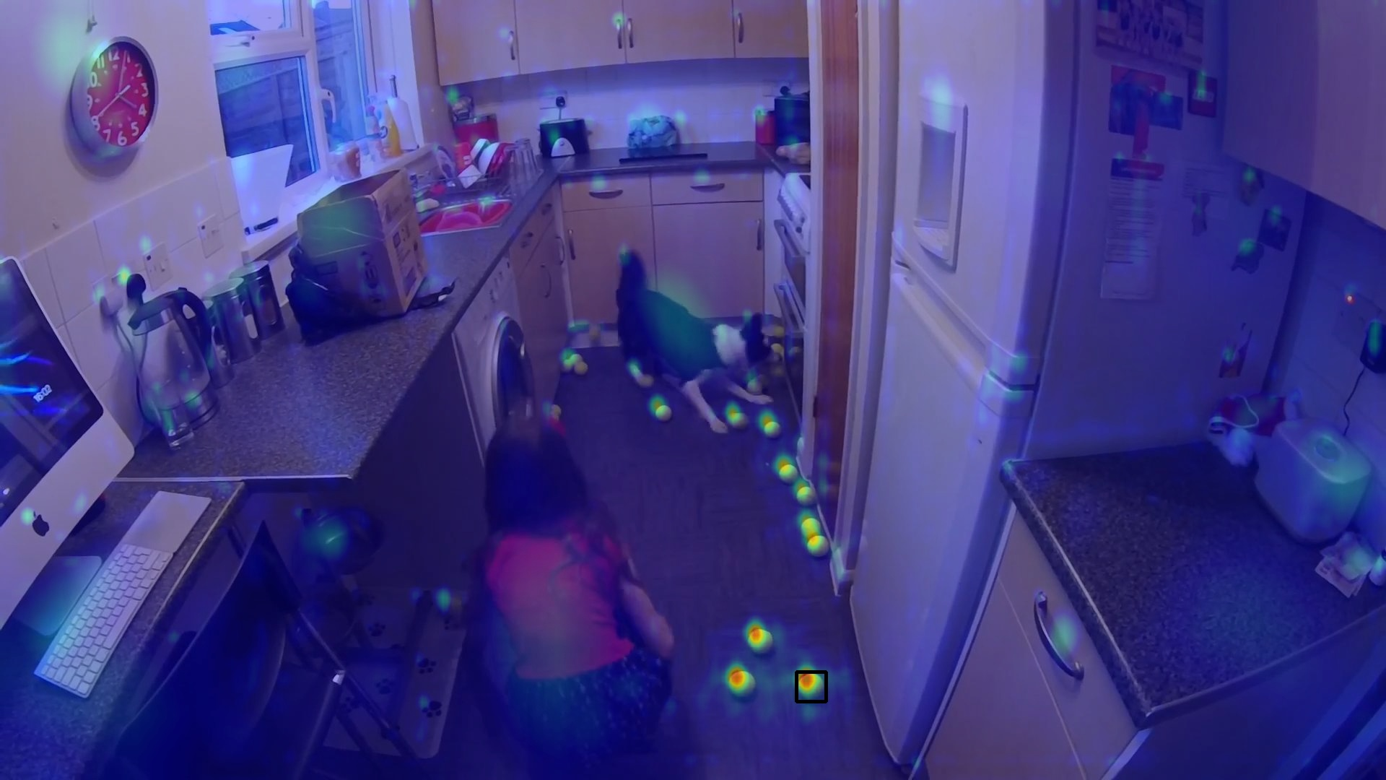
Combine Correlation Heatmap with RPN
Multiply heatmap with cls_score of RPN on all FPN scales.

Slide 23
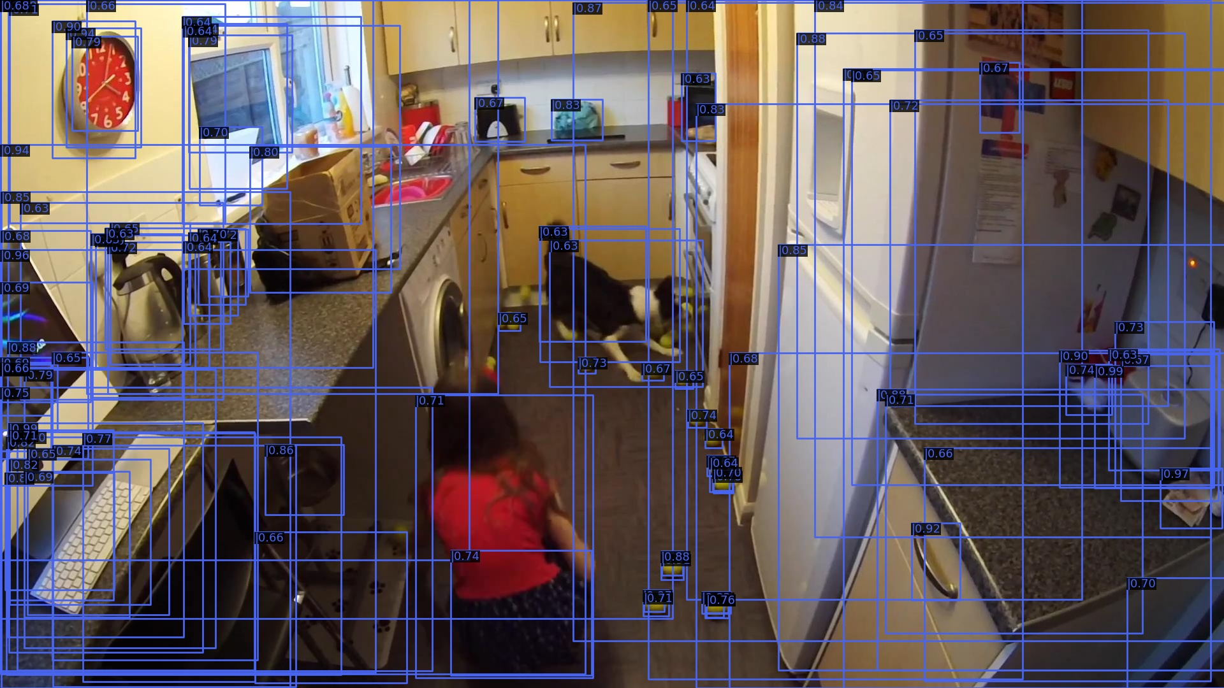
Combine Correlation Heatmap with RPN
Multiply heatmap with cls_score of RPN on all FPN scales.

Slide 24
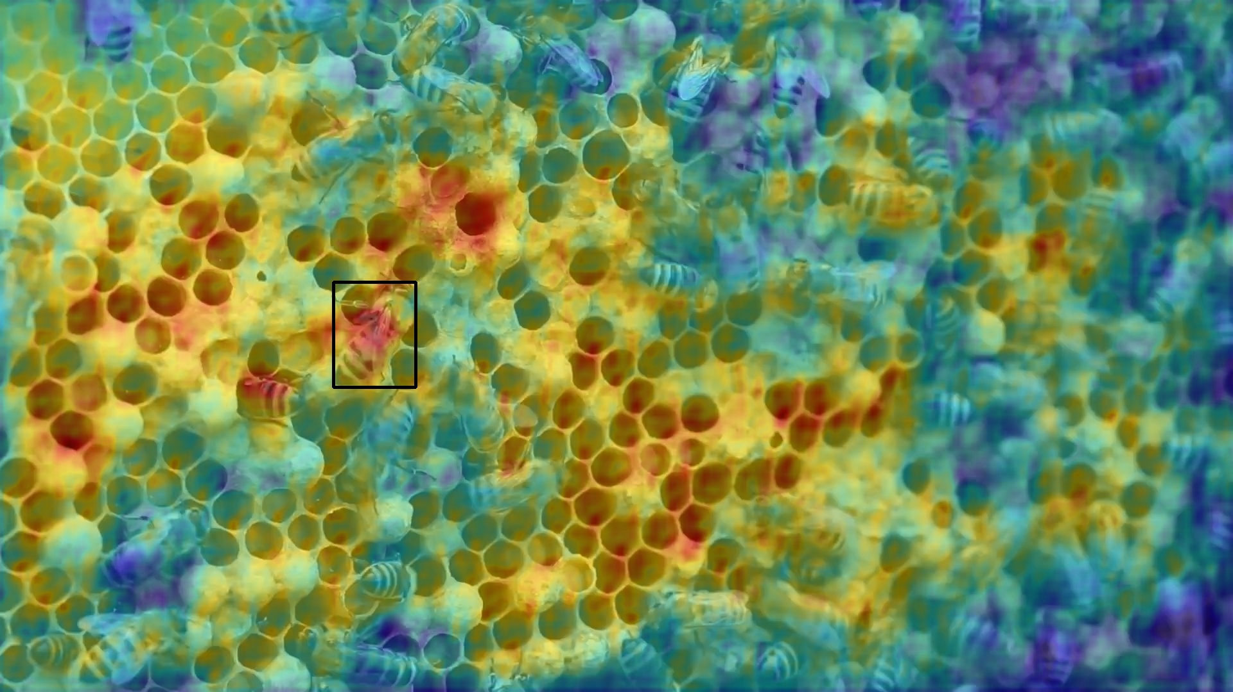
Combine Correlation Heatmap with RPN
Multiply heatmap with cls_score of RPN on all FPN scales.

Slide 25
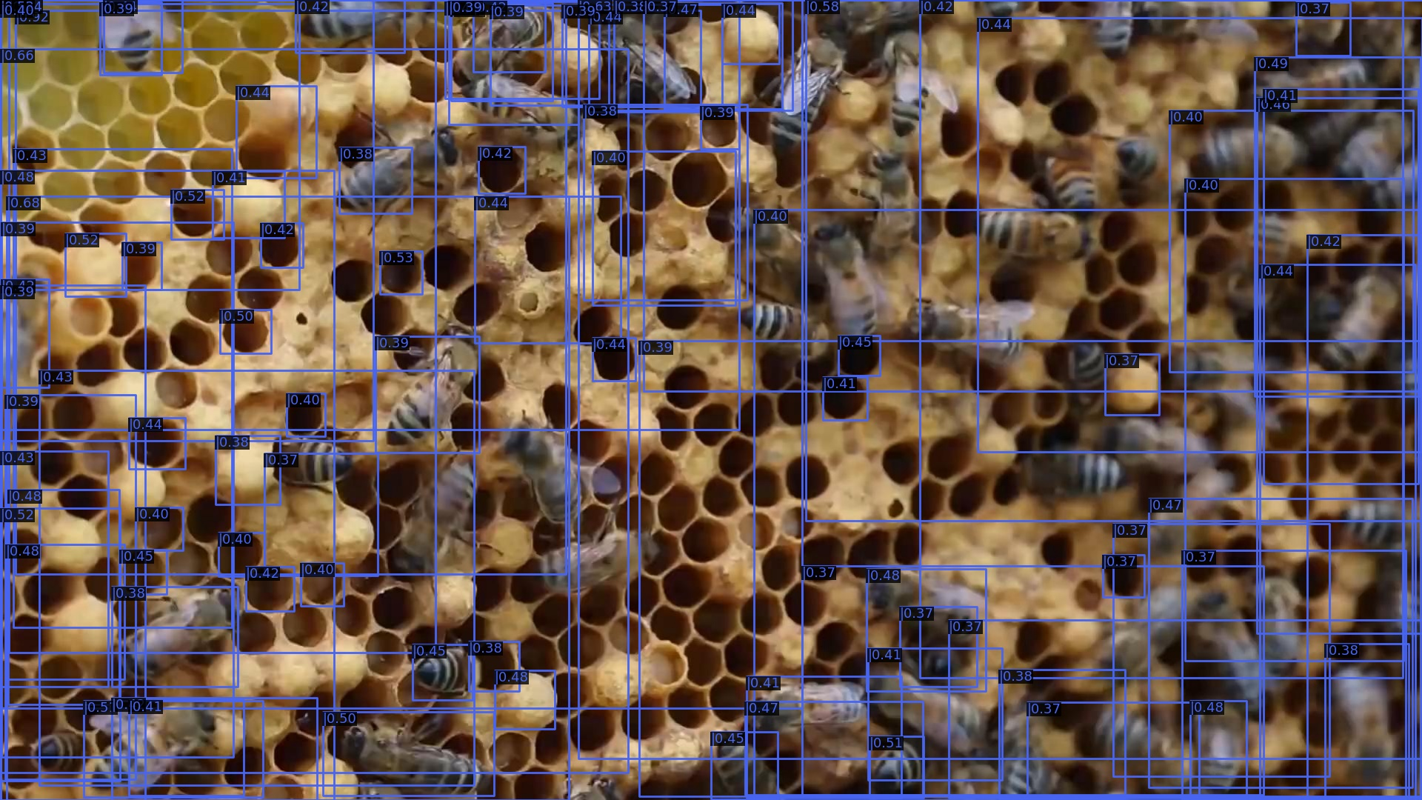
Combine Correlation Heatmap with RPN
Multiply heatmap with cls_score of RPN on all FPN scales.

Slide 26

Combine Heatmap with RPN on single level
Multiply heatmap with cls_score of RPN on single FPN level of template.

Slide 27

Combine Heatmap with RPN on single level
Multiply heatmap with cls_score of RPN on single FPN level of template.

Slide 28
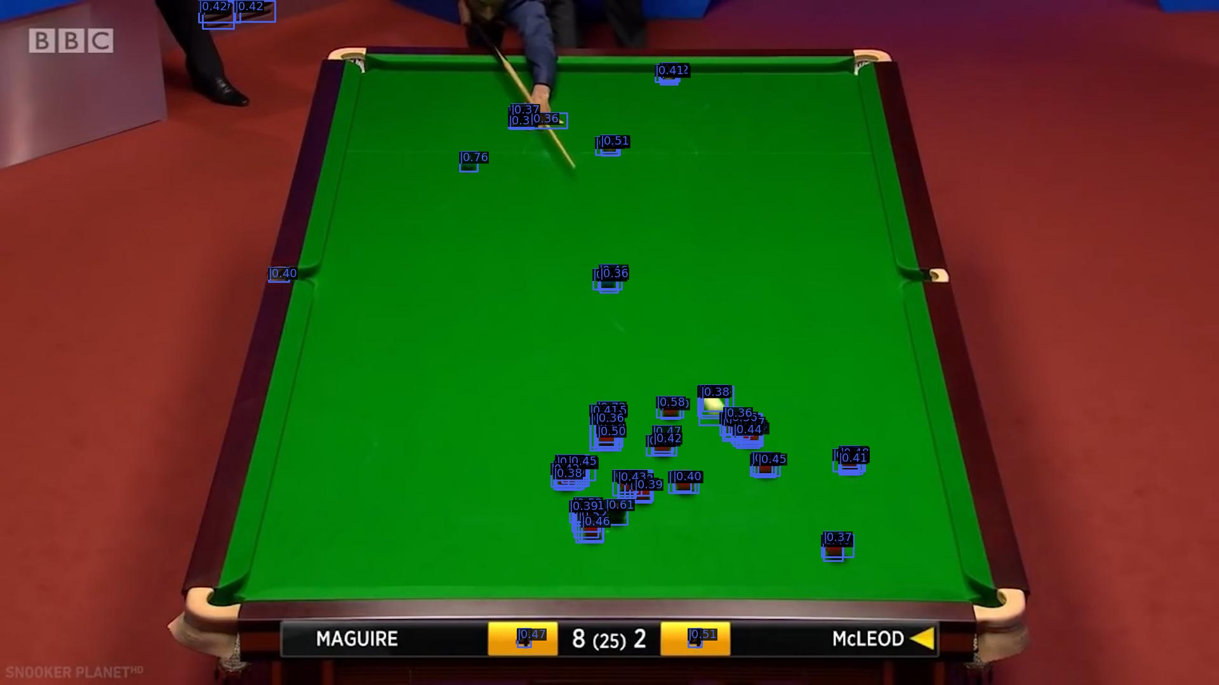
Combine Heatmap with RPN on single level
Multiply heatmap with cls_score of RPN on single FPN level of template.

Slide 29
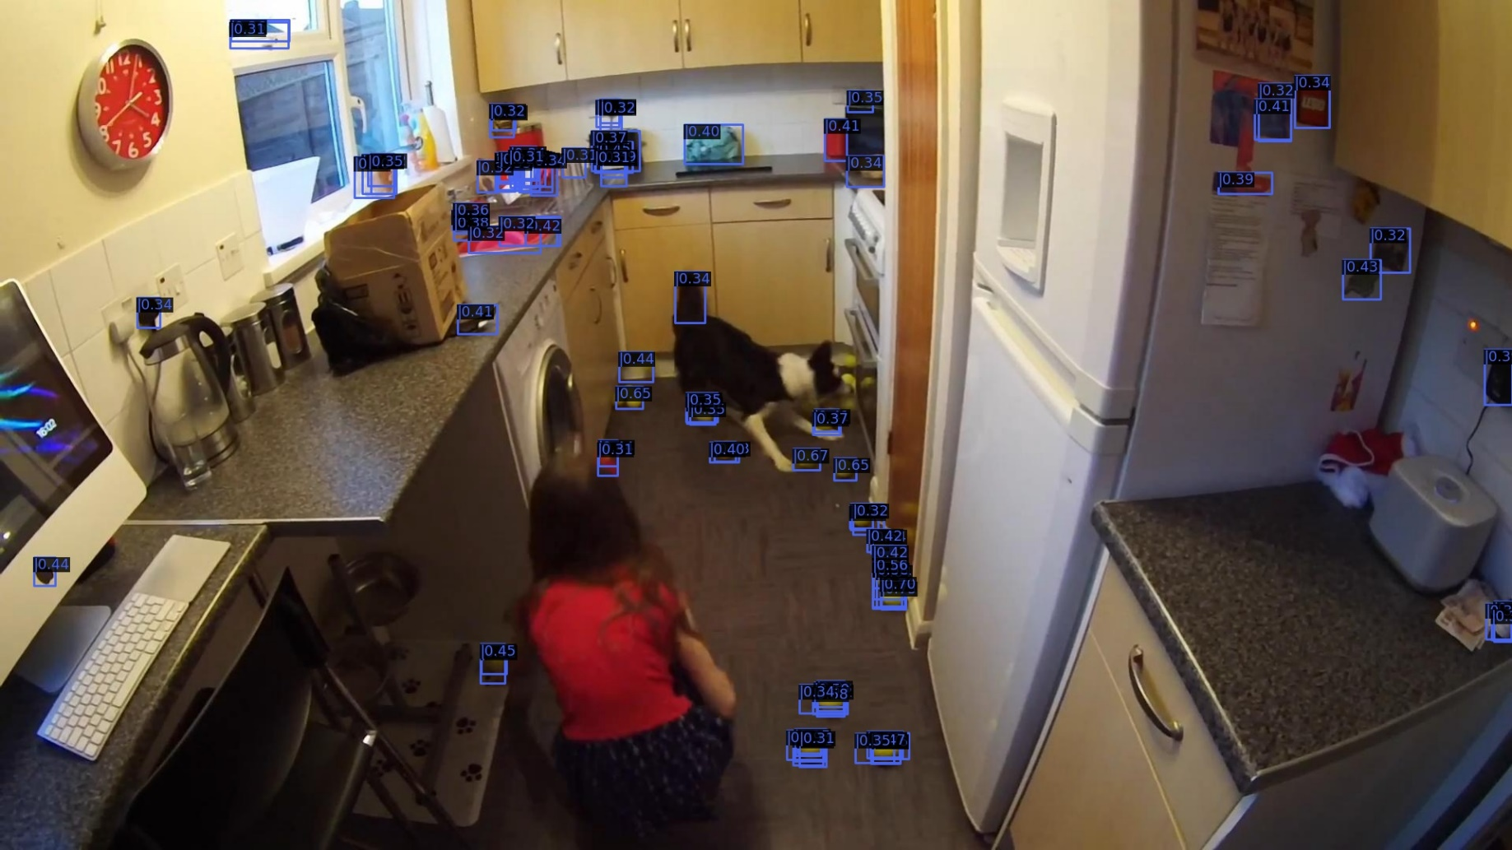
Combine Heatmap with RPN on single level
Multiply heatmap with cls_score of RPN on single FPN level of template.

Slide 30
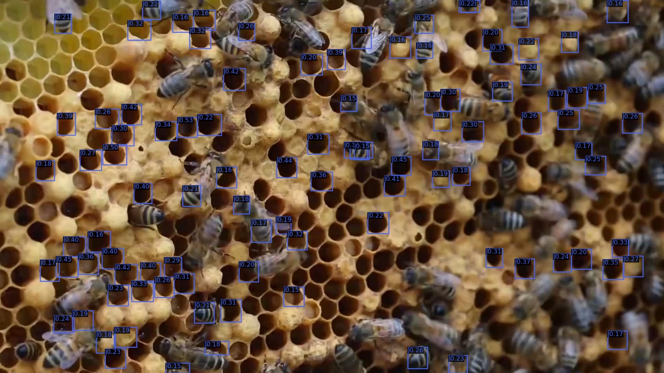
Combine Heatmap with RPN on single level
Multiply heatmap with cls_score of RPN on single FPN level of template.

Slide 31
End
End and Thanks!

